Slide 1


Interactive Data Visualization:
Dash and Plotly Dashboards
Christian Stefani
Center for Sensors & Devices
Fondazione Bruno Kessler
cstefani@fbk.eu www.fbk.eu

Slide 2
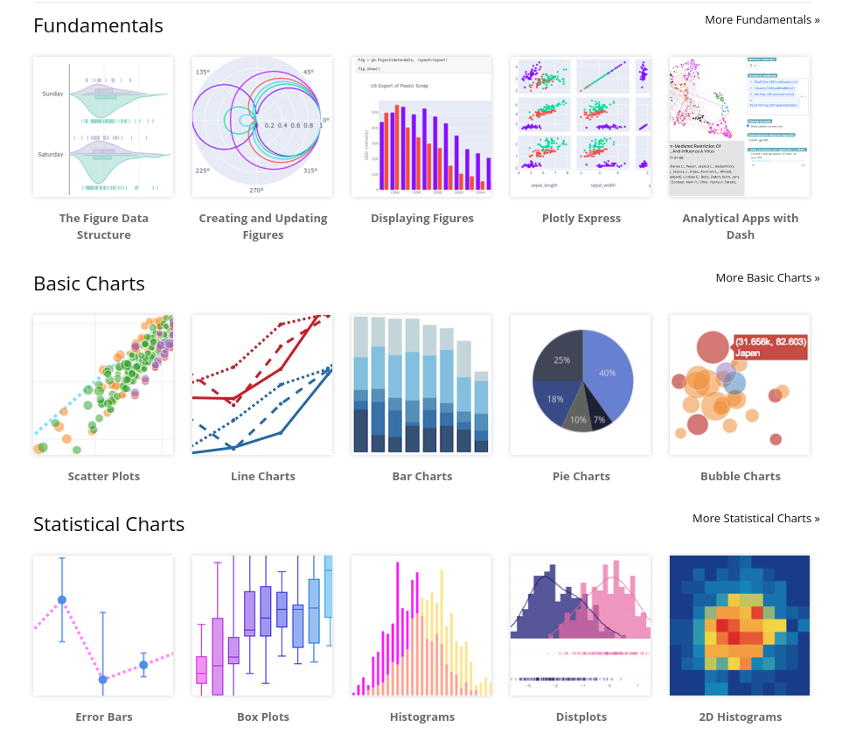
Plotly

Slide 3
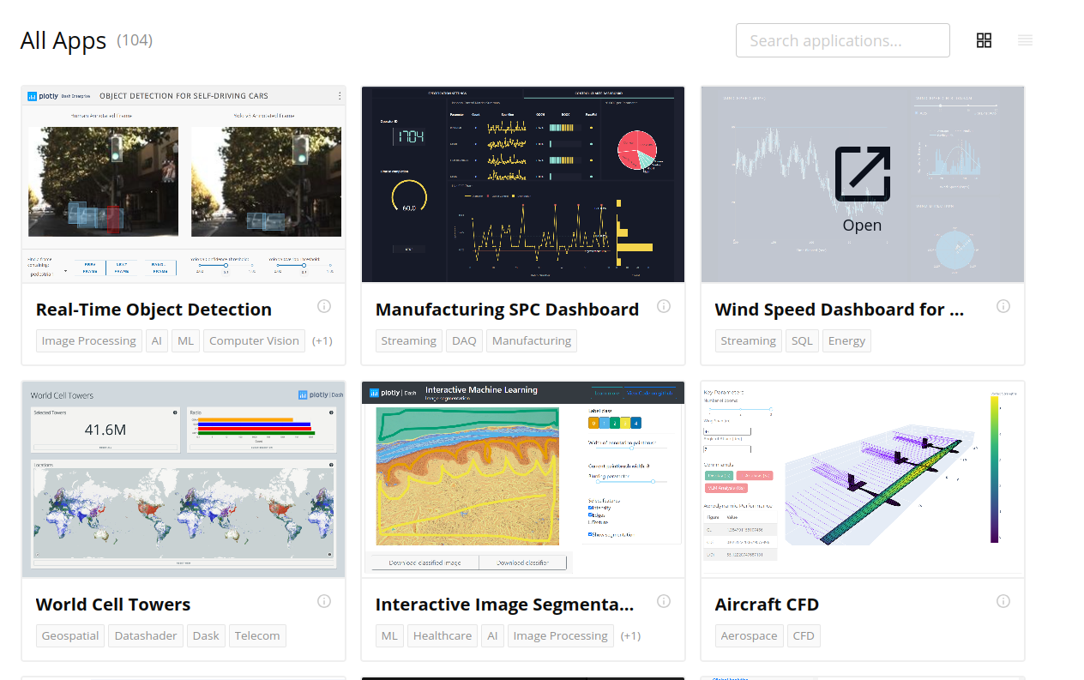
Dash

Slide 4

Why ?
Why Plotly?
Why Dash?
Fast and easy to implement simple plots
Low code/low effort options using plotly.express
(If desired) Extremely customizable
Interactive plots by default
Available in R and Python
Web-based
Open source
Easily versioned
Fast, light-weight (built on top of Flask)
Customizable with Flask
Continuous integration/deployment

Slide 5
Plotly
Plotly graphs can be created:
1. With plotly.express for simple, quick plots ( px )
2. With plotly.graph_objects ( go ) for more customization
3. With plotly.figure_factory for specic, advanced figures
We will spend most of our time on 1 and 2!

Slide 6
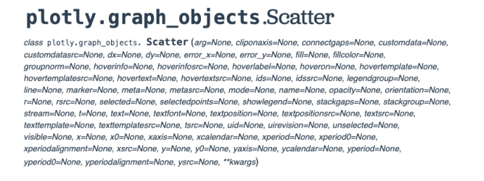
The importance of documentation
Save the links to key documentation!
1. Interactive, introductory docs (with many examples!)
https://plotly.com/python
2. Graph_objects pages for specic plots
Index here
For example, go.scatter here
3. The base go.Figure documentation linked here
Important when we cover update_layout() later!
The go.scatter documentation page:

Slide 7
The Plotly Figure
A Plotly Figure has 3 main components:
layout: Dictionary controlling style of the figure
One layout per figure
data: List of dictionaries setting graph type and data itself
Data + type = a trace. There are over 40 types!
Can have multiple traces per graph

Slide 8
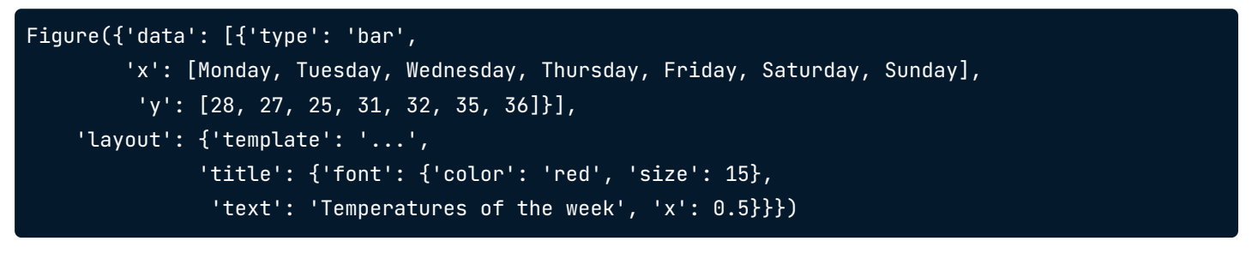
Inside the Plotly Figure
Let’s see inside an example Plotly figure object:
What do you think this graph will look like?

Slide 9
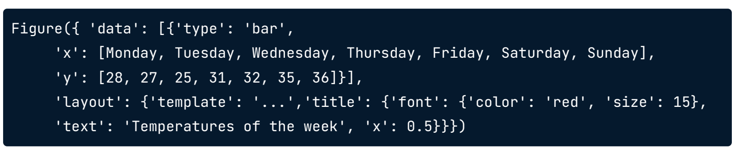
Inside out figure
Type ’bar’
An X and Y axis with data noted
A title with some text around temperatures of the week
Guess: A bar chart of temperatures of the days of the week

Slide 10
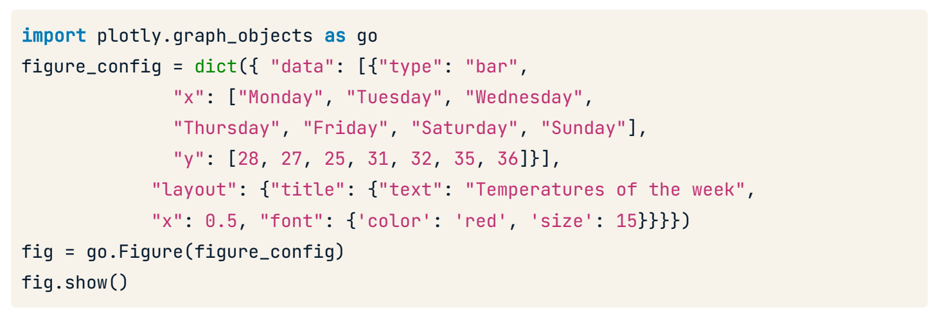
Creating our Figure

Slide 11
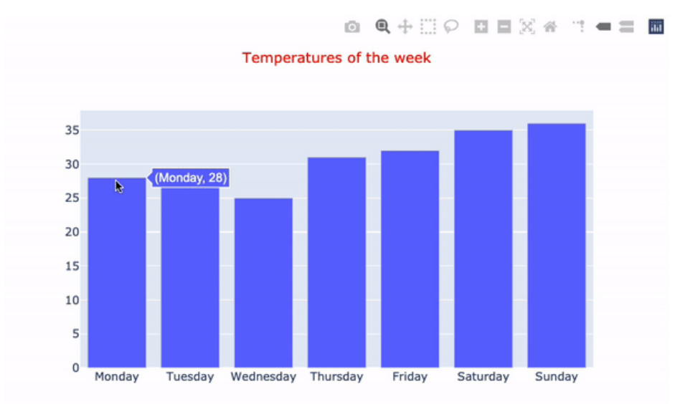
Our Figure relevated
Let’s see what is produced!

Slide 12
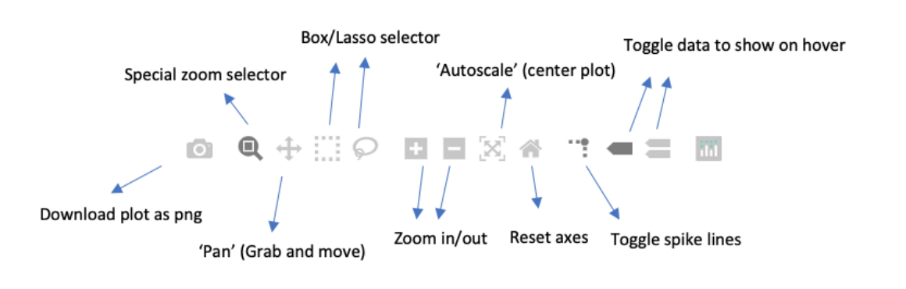
Plotly’s instant interactivity
Plotly provides instant interactivity:
Hover over data points
Extra interactive buttons

Slide 13
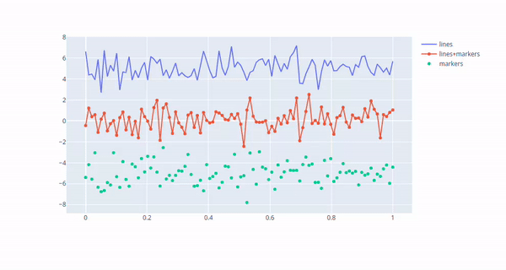
Plotly’s instant interactivity

Slide 14
Univariate visualizations
Plotly shorcut methods:
plotly.express
Specify a DataFrame and its columns as arguments
Quick, nice but less customization
graph_objects go.x methods (go.Bar(), go.Scatter()) etc.
Many more customization options, but more code needed

Slide 15
What are univariate plots?
Univariate plots display only one variable
For analyzing the distribution of that variable
Common univariate plots:
Bar chart
Histogram
Box plot
Density plots

Slide 16
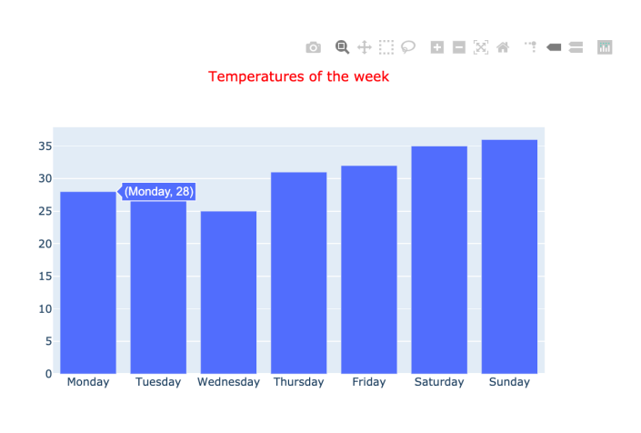
Bar Charts
Bar charts have:
X-axis with a bar per group
One group = one bar! (Hence UNIvariate)
The y-axis height represents the value of some variable

Slide 17
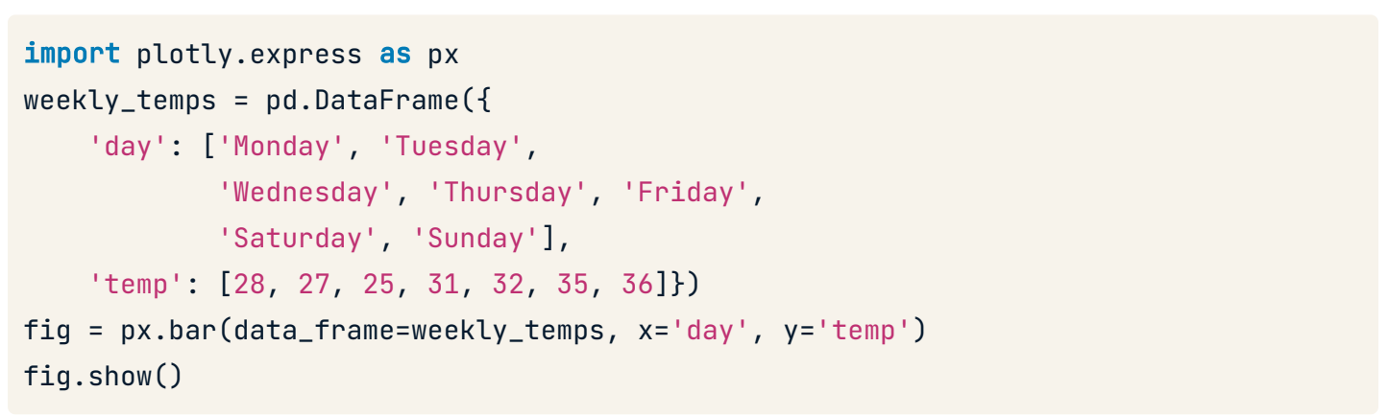
Bar chart
Let's rebuild with plotly.express

Slide 18
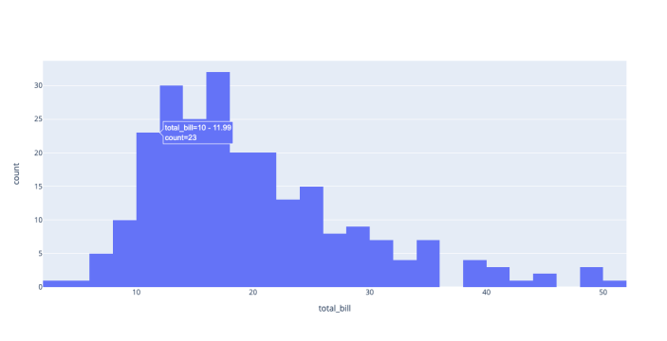
Histograms
Histograms have:
Multiple columns (called 'bins') representing a range of values
The height of each bar = count of samples within that bin range
The number of bins can be manual or automatic

Slide 19
Line chart
import plotly.express as px
df = px.data.gapminder().query("continent=='Oceania'")
fig = px.line(df, x="year", y="lifeExp", color='country')
fig.show()

Slide 20
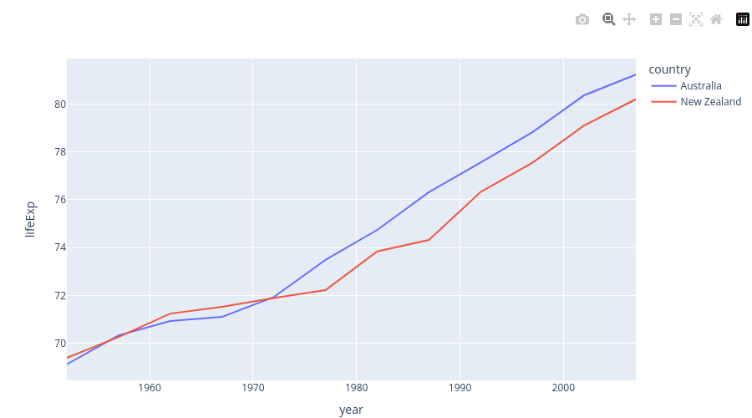
Line chart
Line chart has:
Multiple lines(called trace) representing the values for each group
Including the attribute ‘color’ we can divide the y values into different group

Slide 21
Customizing color
How to customize plots:
At gure creation if an argument exists (like color !)
Using an important function update_layout()
Takes a dictionary argument
E.g.: fig.update_layout({'title':{'text':'A New Title'}})
The method chosen depends on plot type how it was created.
MANY properties possible — See the documentation

Slide 22
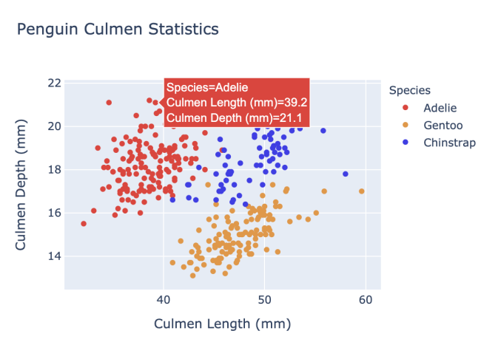
Why customize color?
Customizing color can help you
Make plots look awesome!
Convey analytical insights
Color in this scaerplot adds a 3rd dimension

Slide 23
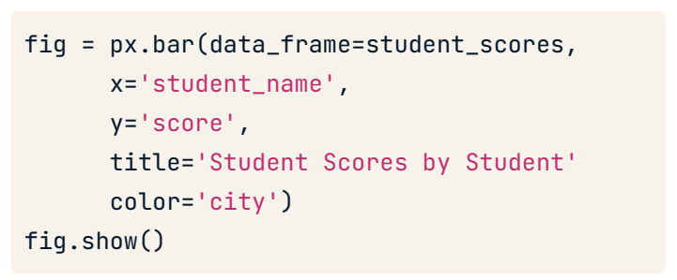
Specifying colors in plotly.express
In plotly.express :
Often a color argument (DataFrame column)
A dierent (automatic) color given to each category in this column
A color scale/range is used if numerical column specied
Our simple bar chart from a previous lesson
(adding a City column)
Make sure to check the documentation for each figure.

Slide 24
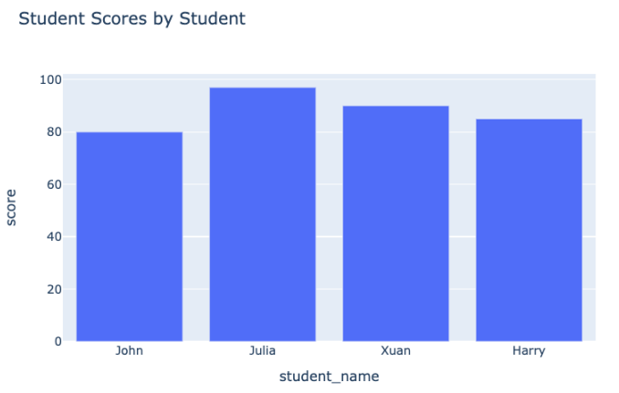
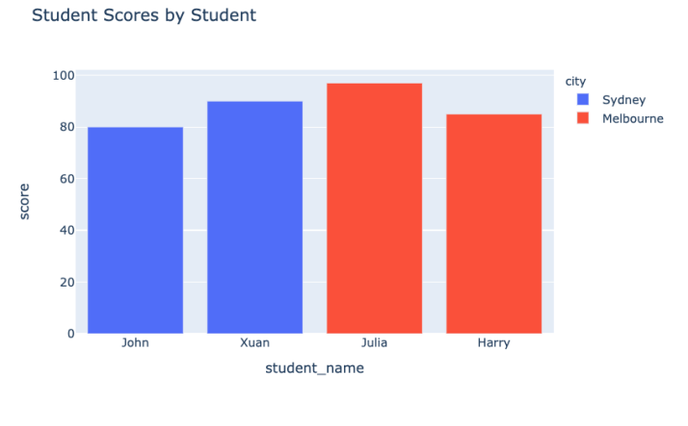
Our colors revealed
The plot before:
Our plot after:

Slide 25
Specific colors in plotly.express
What if we don't like the automatic colors?
color_discrete_map : A dictionary mapping specic categorical values to colors using a string RGB code specication — 'rgb(X,X,X)'
Can also express (basic) colors as strings such as 'red', 'green' etc.

Slide 26
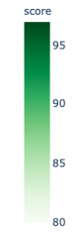
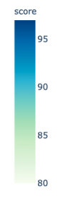
Color scales in plotly.express
You can create color scales too.
Single color scales. For example, light to dark green.
Multiple colors to merge into each other.
For example, green into blue
color_continuous_scale allows us to do this
with built-in or constructed color scales.

Slide 27
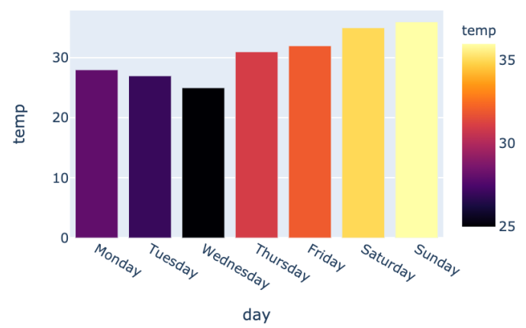
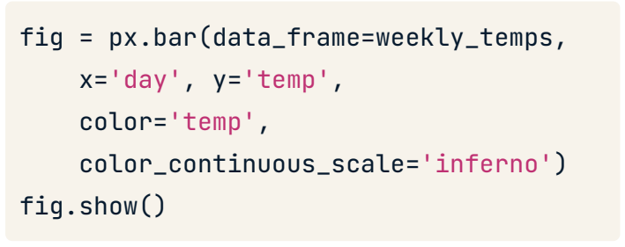
Using built-in color scales
Let's use a built-in color scale:
Our plot:
Many built-in scales available

Slide 28
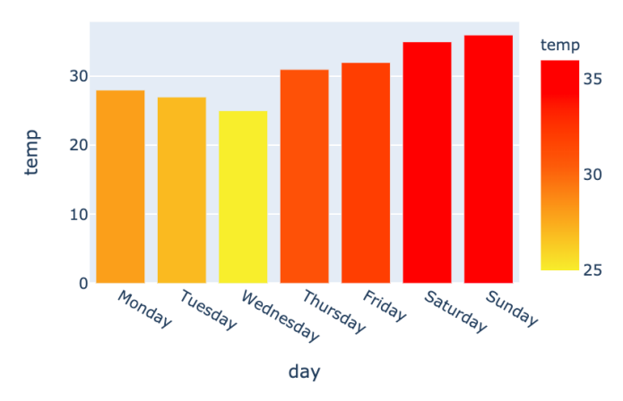
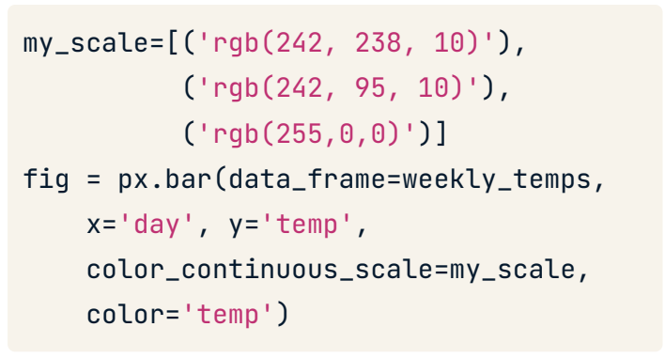
Constructing our own color range
Let's construct our own color scale - yellow through orange to red
Our plot:

Slide 29
Dash
Introducing Dash

Slide 30
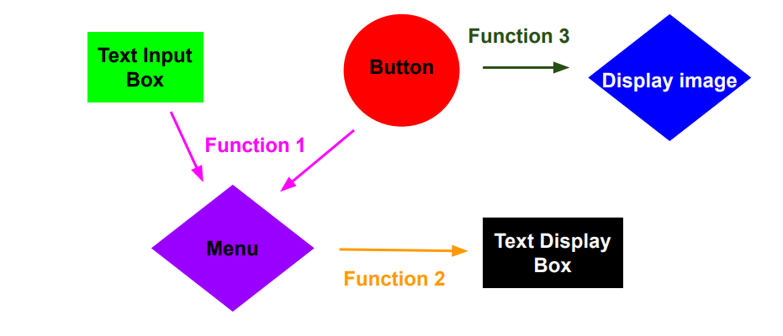
How does it work?
Essential Idea: Web page consists of a collection of components and
collection of functions that are triggered whenever an aspect of a given
component changes.

Slide 31
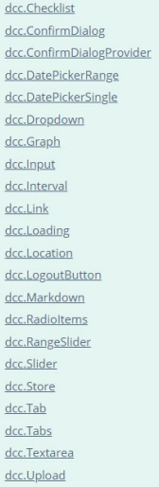
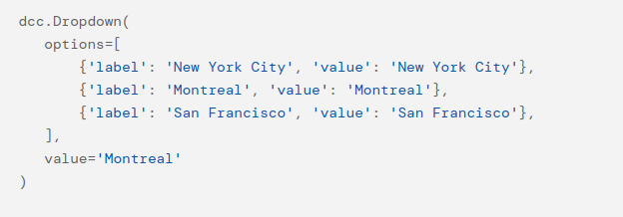
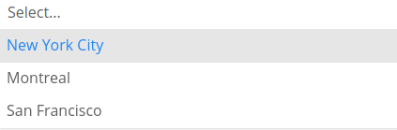
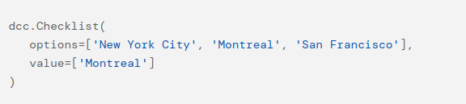

Core components
Populate webpage with various dash core
components or html components.

Slide 32
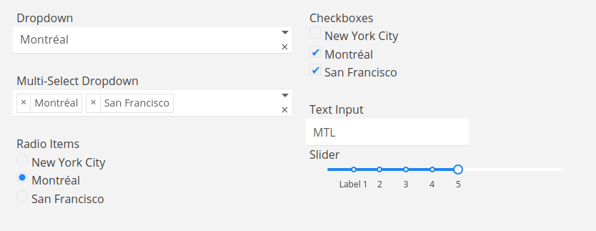
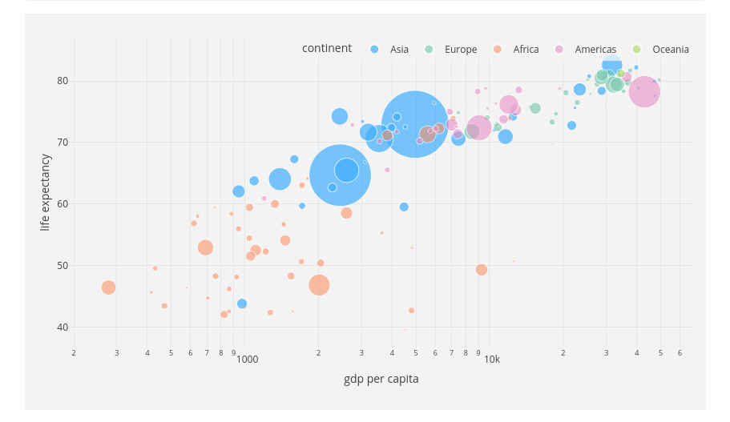
Layout
But, how can we connect all components?

Slide 33
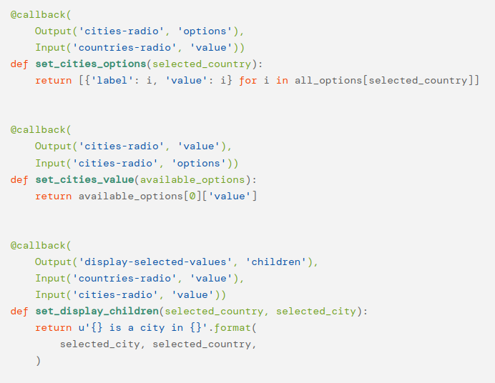
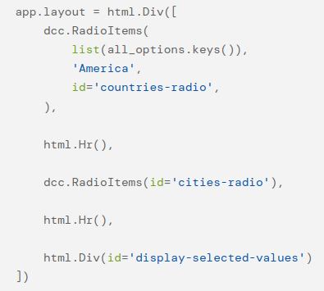
Callbacks
Define functions called callbacks that are triggered when an aspect of a given component changes.
Input
Output

Slide 34
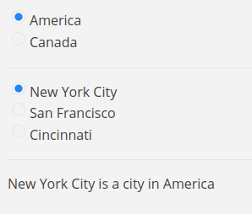
Callbacks
Changing this
Changes this

Slide 35
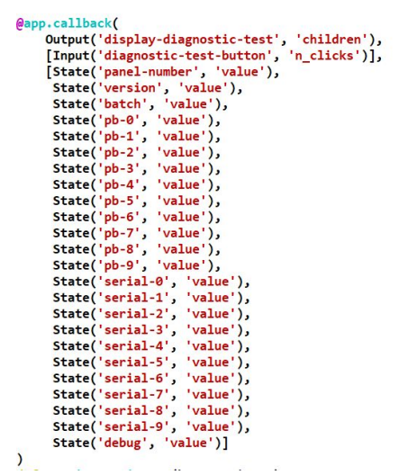
Callbacks
● Everytime you change an input that
is used in a callback, that callback
will fire.
● Can define callbacks with multiple
inputs.
○ Changing any one of those
inputs will trigger the callback.
● Can use States instead, and a
button to trigger the callback.

Slide 36
Css and dash-bootstrap-components
Cascading Style Sheets (CSS) is a stylesheet language used to describe the presentation of a document written in HTML.
CSS describes how elements should be rendered on screen, on paper, in speech, or on other media.
Bootstrap is the most popular CSS Framework for developing responsive and mobile-first websites.
In particuraly, dash-bootstrap-components is a library of Bootstrap components for Plotly Dash, that makes it easier to build consistently styled apps with complex, responsive layouts.

Slide 37
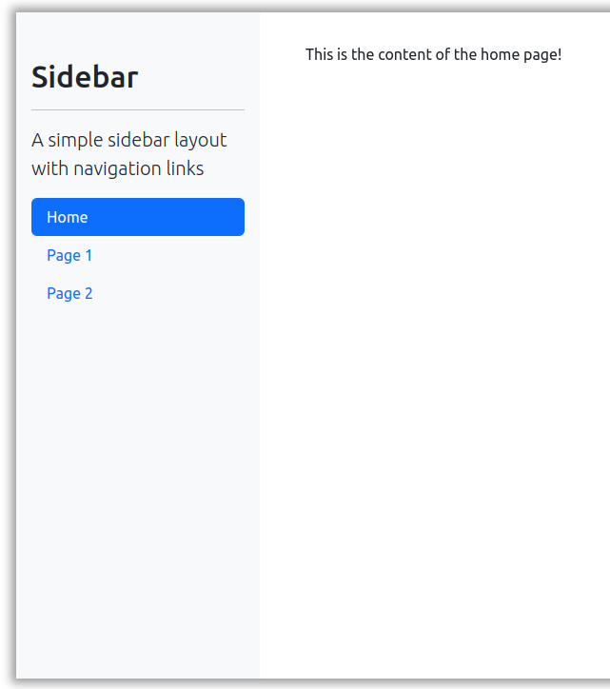
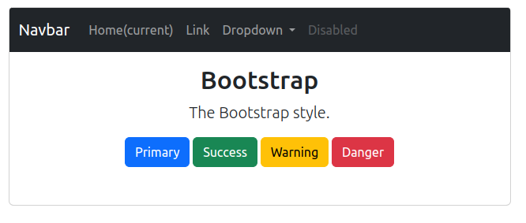
Css and dash-bootstrap-components

Slide 38
Dash
Let's practice!

Slide 39
Installation
pip install dash
pip install dash-html-components
pip install dash-core-components
pip install dash-bootstrap-components
pip install plotly
pip install pandas

Slide 40
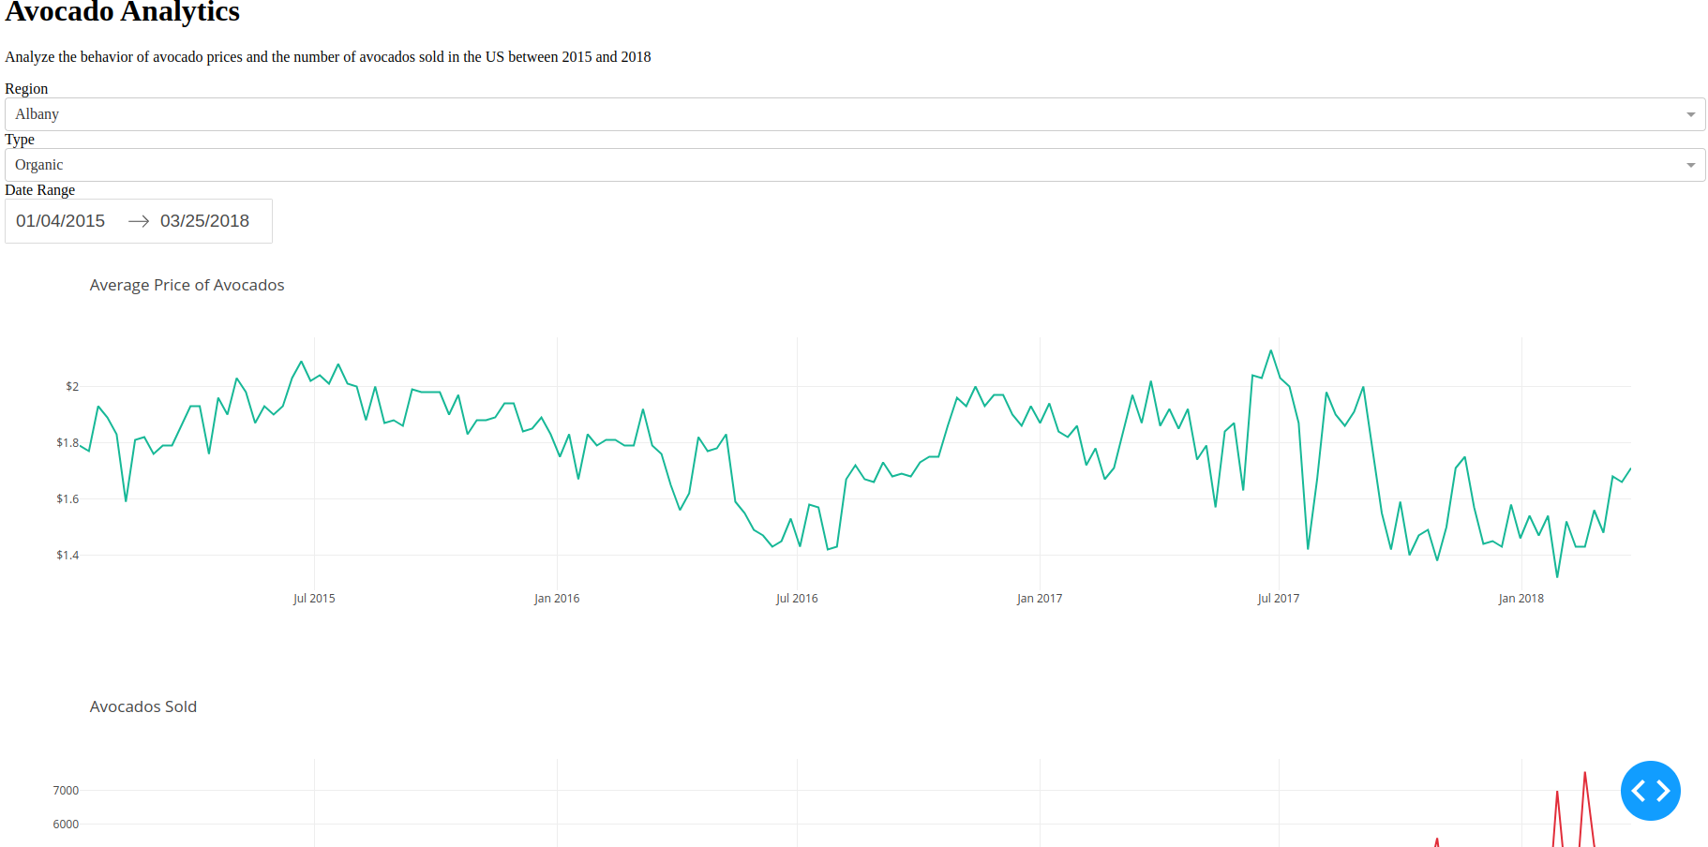
Dashboard

Slide 41
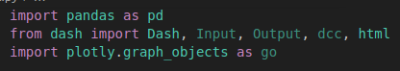
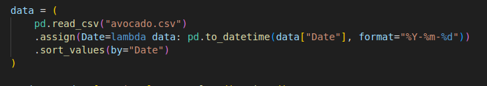
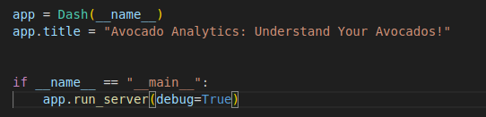
First steps

Slide 42
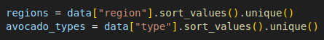
Layout
This is our container for the layout
We are going to put all compentents into it
Dropdown, date picker, checkbox etc.
First we have to save the values for the dropdown menus

Slide 43
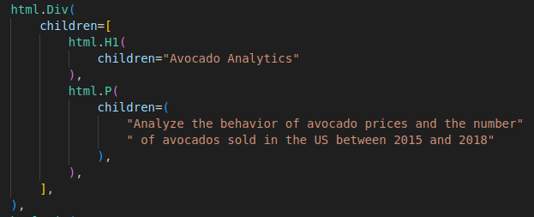
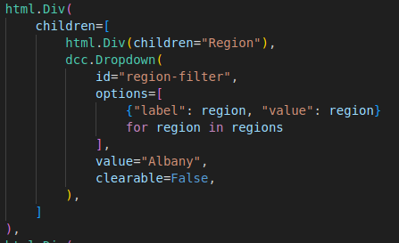
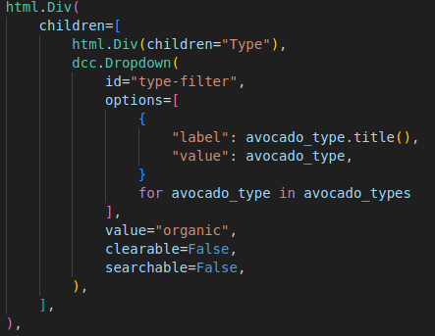
Layout
First of all, we need to create the title with a little description.
And then, the two dropdown menus.

Slide 44
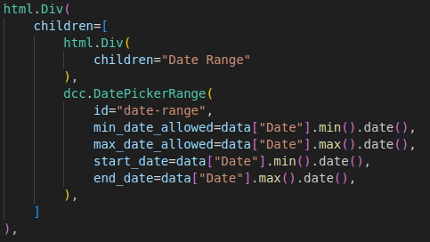
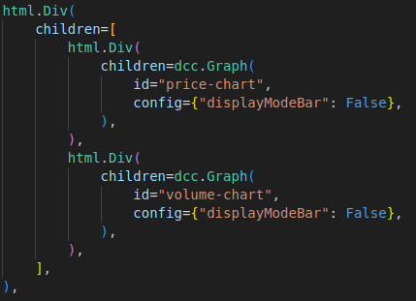
Layout
Set up our date picker (for a better date picker see Dash mantine)
Finally, we can add the two graph containers.

Slide 45
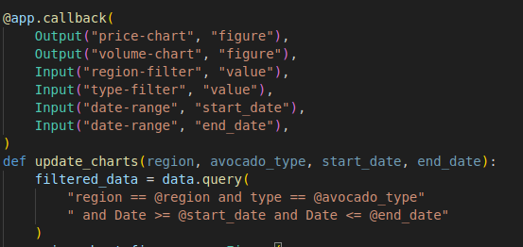
Callbacks
This is the head of our callback
Which are the input elements?
What we have to show?

Slide 46
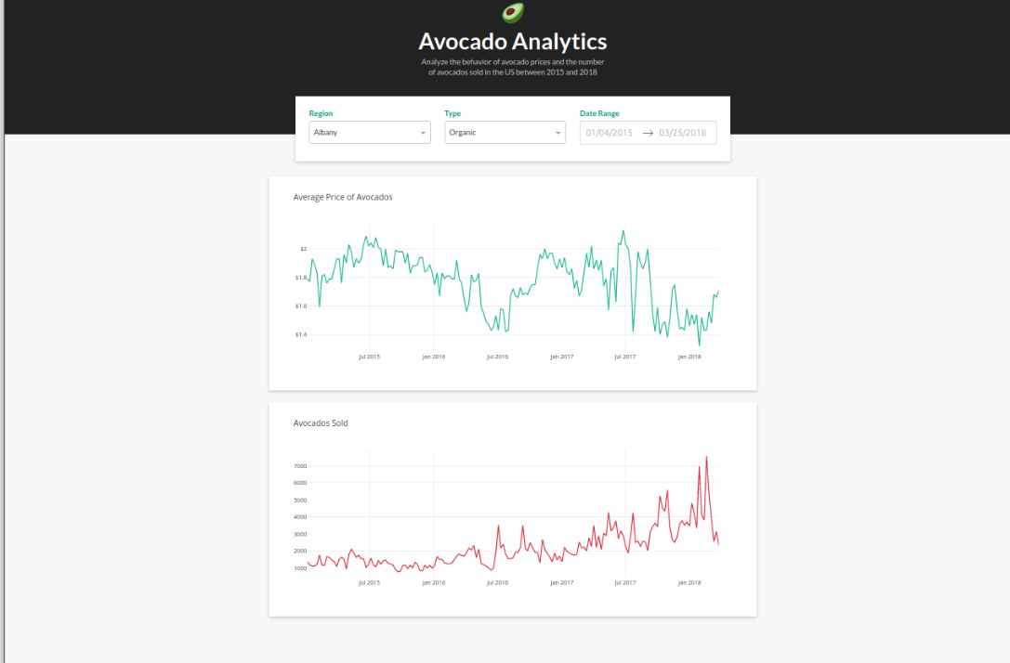
Customize
And now try to customize again and again...

